Slide 1
EGFR-Mutated Non‑Small Cell Lung Cancer second-line and beyond
Gregory J. Riely, MD, PhD
Memorial Sloan Kettering Cancer Center

Slide 2
Disclosures
Institutional research support from Mirati, Lilly, Takeda, Merck, Roche, Pfizer, Rain Therapeutics, and Novartis.

Slide 3
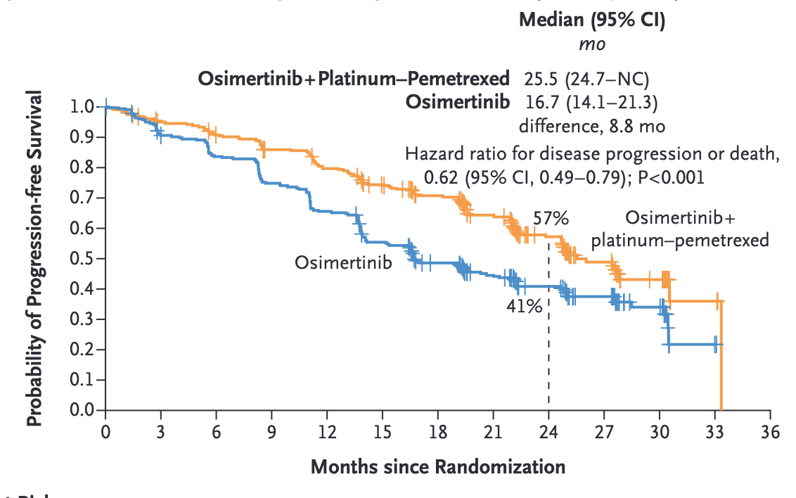
What do we do after first line single-agent TKI or combination therapy?
Planchard et al, NEJM 2023

Slide 4
What do we do after first line single-agent TKI or combination therapy?
Reminder: median time on chemotherapy in combination arm of FLAURA2 was 8 months
And…
The other arm hasn’t had chemo
Mariposa – median amivantamab exposure was 15 months
Planchard et al, NEJM 2023

Slide 5
When we think about chemotherapy after TKI, do we continue the TKI? COMPEL, randomized double-blind phase III
Advanced NSCLC
EGFR exon 19 deletion or L858R
Non-CNS progression on first-line osimertinib after response or stable disease ≥6 months
Stable CNS metastases allowed
No subsequent therapy
WHO performance status 0 / 1
Osimertinib +
Platinum + Pemetrexed
(n=49)
Placebo +
Platinum + Pemetrexed
(n=49)
Primary endpoint: PFS by investigator assessment
Secondary endpoints: CNS PFS by baseline CNS metastasis status, non-CNS PFS, overall survival, safety
Peled et al, ESMO Open 2025

Slide 6
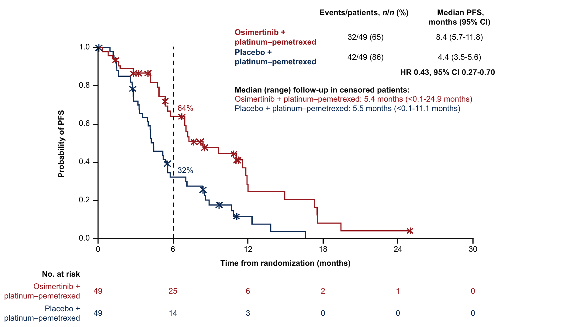
Continuation of osimertinib associated with improved Progression-Free Survival
Primary endpoint, investigator-assessed, all randomized patients
Peled et al, ESMO Open 2025
Notes:
Figure 1. Sample size was reduced from about 204 to 98 patients, so analyses were descriptive with no formal hypothesis testing. Data cutoff 28 October 2024.

Slide 7
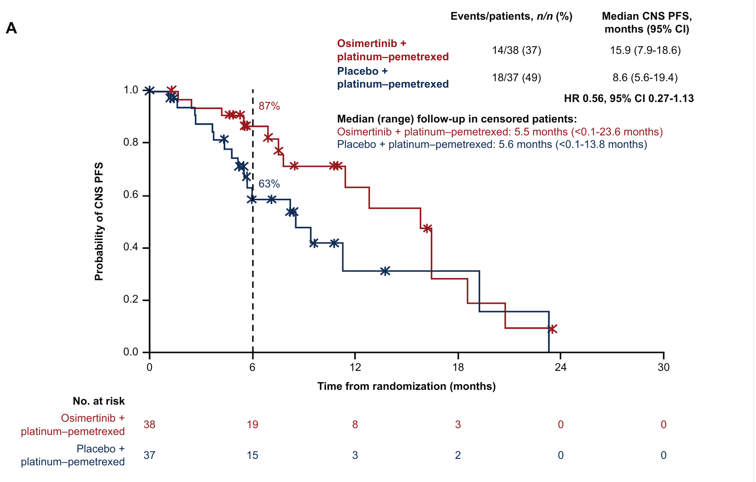
Continuation of osimertinib associated with improved CNS Progression-Free Survival
Patients without CNS metastases at baseline (n=75)
Peled et al, ESMO Open 2025
Notes:
Figure 2A. In the 23 patients with stable baseline CNS metastases, 6-month CNS PFS was 82% vs 56%, HR not calculated (9 events).

Slide 8
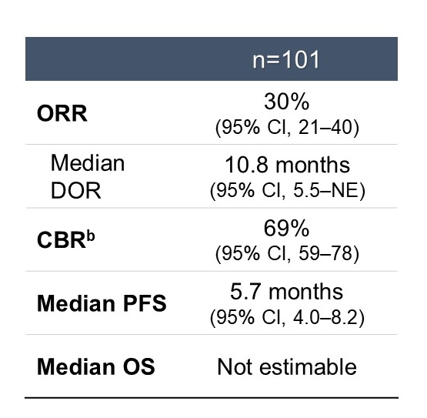
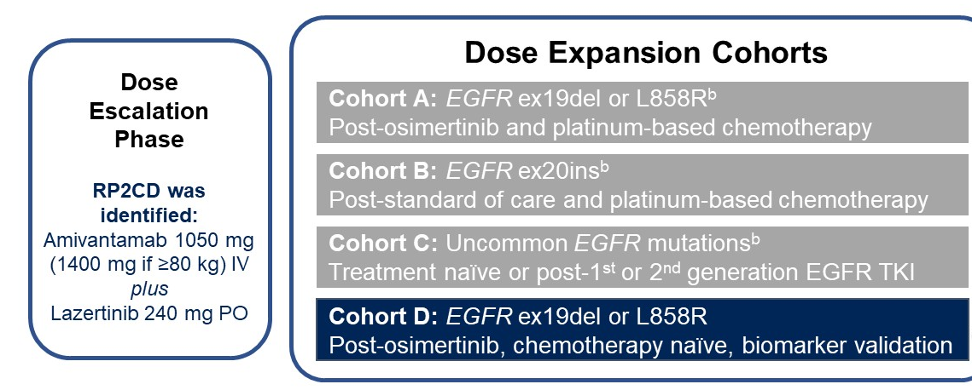
Amivantamab + Lazertinib After Osimertinib
CHRYSALIS-2 – modest single–arm data support use
Besse et al, ASCO 2023

Slide 9
Chemotherapy + Amivantamab +/- lazertinib
MARIPOSA-2, randomized phase III
Amivantamab + Lazertinib + Carboplatin + Pemetrexed
(n=263)
Locally advanced or metastatic NSCLC
EGFR exon 19 deletion or L858R
Progression on osimertinib as most recent therapy
Stable, asymptomatic brain metastases allowed
Amivantamab + Carboplatin + Pemetrexed
(n=131)
Carboplatin + Pemetrexed
(n=263)
Dual primary endpoints: PFS by blinded independent central review for each amivantamab arm vs chemotherapy
Secondary endpoints: response rate, duration of response, overall survival, intracranial PFS, safety
Passaro et al, Ann Oncol 2024

Slide 10
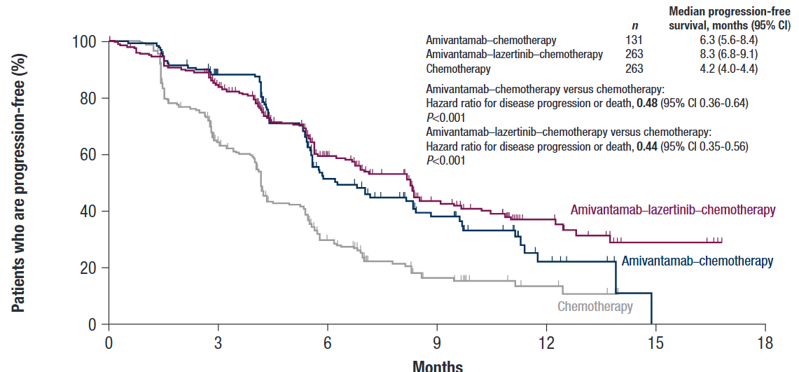
Amivantamab + Chemotherapy After Osimertinib
MARIPOSA-2, PFS
Passaro et al, Ann Oncol 2024

Slide 11
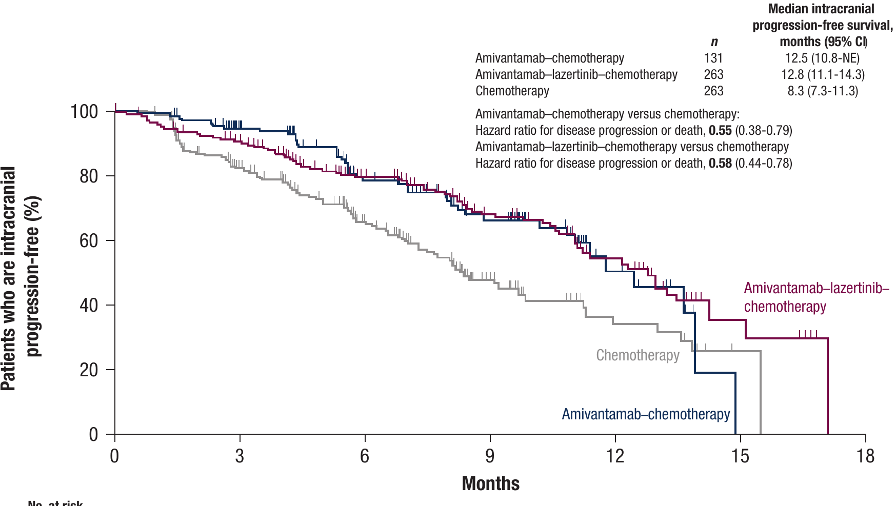
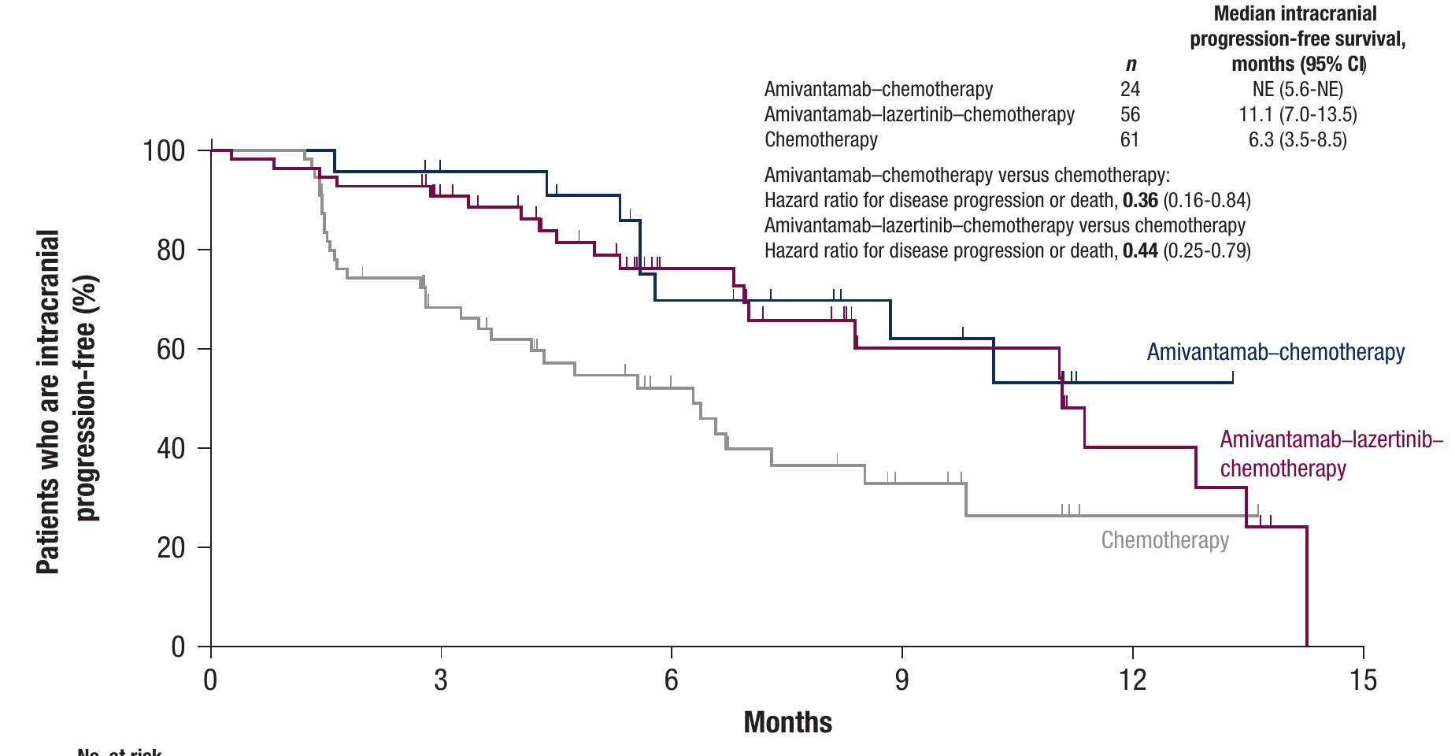
Intracranial Progression-Free Survival
MARIPOSA-2, BICR
All randomized patients
Brain metastases, no prior radiotherapy
HR 0.55 and 0.58 vs chemotherapy
HR 0.36 and 0.44 vs chemotherapy
Median intracranial PFS 12.5 and 12.8 vs 8.3 months in all randomized patients
Passaro et al, Ann Oncol 2024

Slide 12
Does adding an immune checkpoint inhibitor help?
KEYNOTE-789
Stage IV nonsquamous NSCLC
EGFR exon 19 deletion or L858R
Progression on EGFR TKI
Prior osimertinib if T790M positive
Performance status 0 / 1
Stable, treated brain metastases
Pembrolizumab +
Platinum + Pemetrexed
(n=245)
Placebo +
Platinum + Pemetrexed
(n=247)
Dual primary endpoints: PFS by central review and overall survival
Secondary endpoints: response rate, duration of response, quality of life, safety
Yang et al, JCO 2024

Slide 13
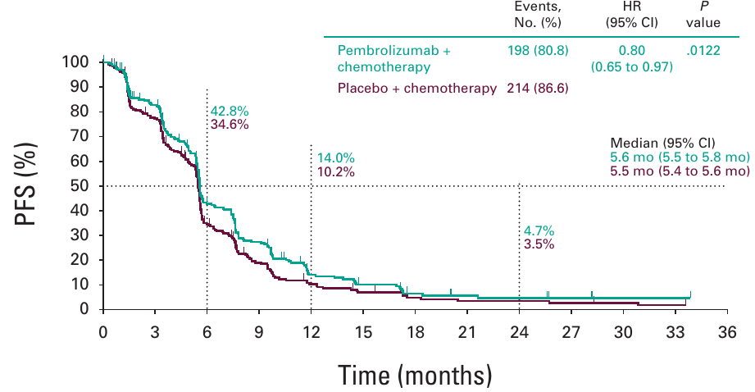
No Significant Improvement in PFS with adding pembrolizumab to chemotherapy
KEYNOTE-789, PFS by central review at second interim analysis
PFS HR 0.80
95% CI, 0.65-0.97
P = .0122
(boundary .0117)
Median 5.6 vs 5.5 mo
Yang et al, JCO 2024

Slide 14
Does using a PD-1/VEGF bispecific make a difference?
HARMONi, randomized phase III
Stage IIIB-IV nonsquamous NSCLC
EGFR activating mutation
Progression on 3rd generation EGFR TKI
Performance status 0 / 1
Ivonescimab +
Carboplatin + Pemetrexed
(n=219)
Placebo +
Carboplatin + Pemetrexed
(n=219)
Dual primary endpoints: PFS by independent radiology review and overall survival
Secondary endpoints: response rate, duration of response, safety, pharmacokinetics
Le et al, Lancet Oncol 2026

Slide 15
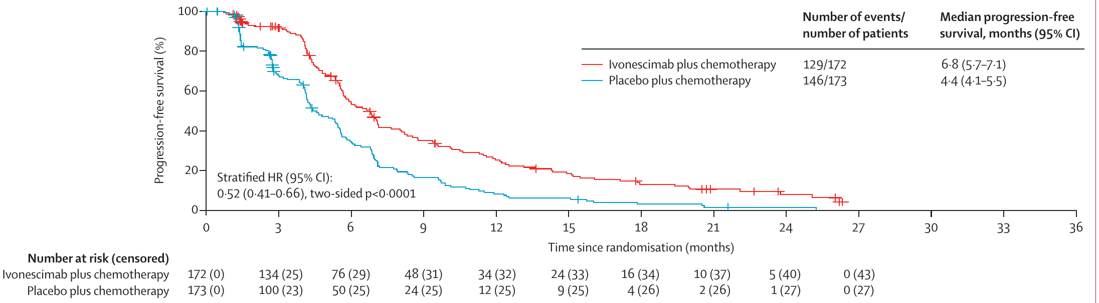
Ivonescimab + chemotherapy improves Progression-Free Survival
Primary analysis by independent radiology review (n=345)
Median PFS 6.8 vs 4.4 months, HR 0.52 (95% CI 0.41-0.66), p<0.0001
Le et al, Lancet Oncol 2026
Notes:
Data cutoff June 10, 2024. Investigator-assessed PFS: 7.1 vs 4.8 months, HR 0.58 (95% CI 0.45-0.73).

Slide 16
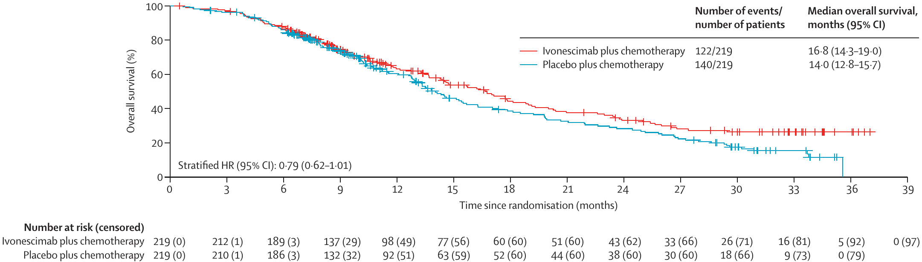
Ivonescimab does not improve Overall Survival
Primary OS analysis, intention-to-treat (n=438)
Median OS 16.8 vs 14.0 months, HR 0.79 (95% CI 0.62-1.01), p=0.057
Le et al, Lancet Oncol 2026
Notes:
Data cutoff April 12, 2025. Median follow-up 29.7 months overall, 32.7 months in the Asian cohort and 9.2 months in the Western cohort. 47 Western OS events had occurred versus 72 anticipated.

Slide 17
Chemo and combinations in EGFR-Mutant NSCLC After Osimertinib
Only FDA-approved option
Trial (regimen) | Exp ORR | Exp PFS, mo | PFS HR
MARIPOSA-2 (ami-chemo, n=394) | 64% | 6.3 | 0.48
HARMONi (ivo-chemo, n=438) | 45% | 6.8 | 0.52
COMPEL (osi-chemo, n=98) | 35% | 8.4 | 0.43
Keynote-789 (pembrolizumab, n=492) | 29% | 5.6 | 0.80
Fang et al, NEJM 2025; Passaro et al, Ann Oncol 2024; Goldman et al, WCLC 2025; Peled et al, ESMO Open 2025; Ahn et al, J Thorac Oncol 2025; Yu et al, JCO 2023; Hong et al, Ann Oncol 2026

Slide 18
What about ADCs in EGFR mutant NSCLC?
Trop2, HER3, and EGFR x HER3 targeting
 | Sac-TMT | Dato-DXd | HER3-DXd | Iza-bren
Target | Trop2 | Trop2 | HER3 | EGFR x HER3
Antibody | Humanized IgG1 (hRS7) | Humanized IgG1 | Fully human IgG1 | Tetravalent bispecific
Linker | Pyrimidine-thiol, hydrolyzable | GGFG tetrapeptide, cleavable | GGFG tetrapeptide, cleavable | Tetrapeptide-based, cleavable
Payload | KL610023 (belotecan derivative) | DXd (exatecan derivative) | DXd (exatecan derivative) | Ed-04 (exatecan derivative)
DAR | 7.4 | 4 | ~8 | ~8
Antibody
Binds the target antigen
Linker
Controls stability and payload release
Payload
Topo I inhibitor, crosses membranes
DAR = payload molecules per antibody

Slide 19
Datopotamab Deruxtecan in EGFR-Mutant NSCLC
Pooled Cohort Supporting FDA Approval
TROPION-Lung05
Phase II, single arm
Actionable genomic alterations
Dato-DXd (n=137)
EGFR mutant
Prior EGFR TKI + platinum
(n=77)
Pooled cohort
Dato-DXd 6 mg/kg q3w
(n=114)
TROPION-Lung01
Phase III, Dato-DXd vs docetaxel
With or without genomic alterations
Dato-DXd arm (n=297)
EGFR mutant
Prior EGFR TKI + platinum
(n=37)
TROPION-Lung05
(n=77)
TROPION-Lung01
(n=37)
Pooled
(n=114)
ORR (95% CI)
45% (34, 57)
43% (27, 61)
45% (35, 54)
Median DOR, months (95% CI)
6.9 (4.2, 10.2)
6.5 (4.0, 8.4)
6.5 (4.2, 8.4)
ORR and DOR by blinded independent central review per RECIST v1.1.
Investigator-assessed ORR in TROPION-Lung05 was 34% (95% CI 23, 45).
Dato-DXD USPI, June 2025

Slide 20
Sacituzumab Tirumotecan vs Chemotherapy
Randomized Trial
Advanced nonsquamous NSCLC
EGFR mutation
Progression on EGFR TKI
T790M negative if no prior 3rd generation TKI
Performance status 0 / 1
Sacituzumab tirumotecan
(n=188)
Pemetrexed + Carboplatin or Cisplatin
(n=188)
Primary endpoint: PFS by blinded independent review
Secondary endpoints: overall survival, investigator-assessed PFS, response rate, disease control rate, duration of response, safety
Fang et al, NEJM 2026

Slide 21
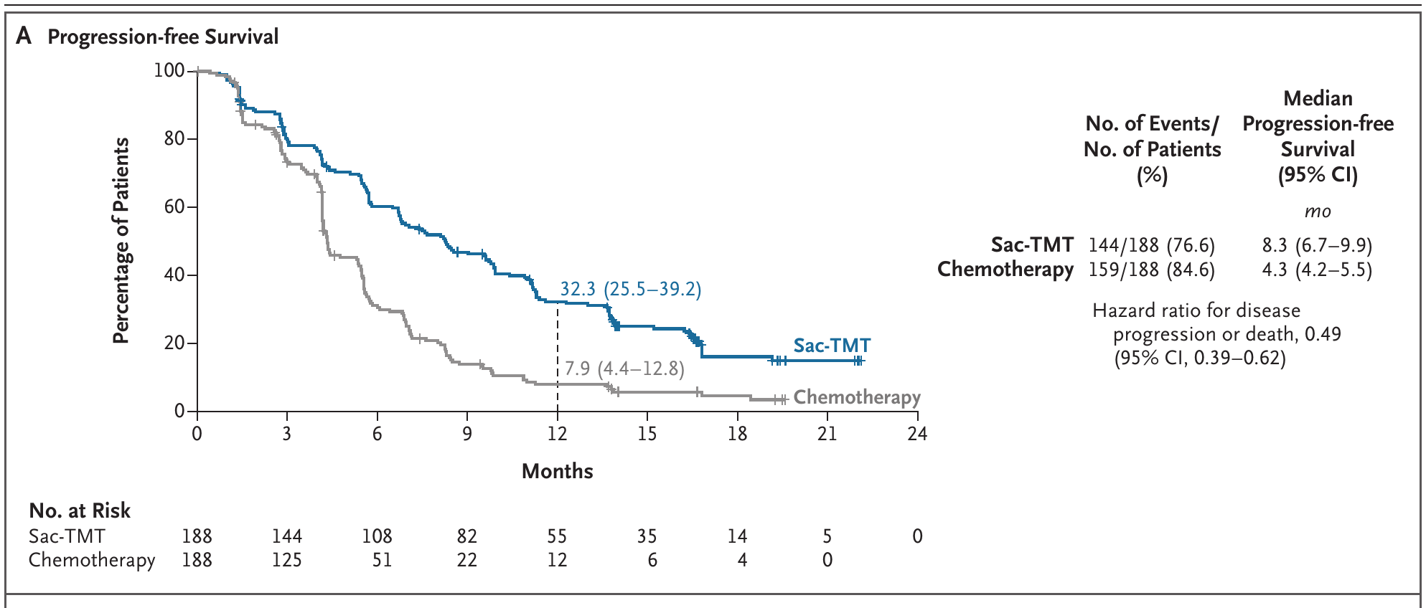
Sac-TMT Improves Progression-free Survival
OptiTROP-Lung04, final analysis by BICR
HR 0.49 (95% CI, 0.39-0.62), median PFS 8.3 vs 4.3 months
Fang et al, NEJM 2026

Slide 22
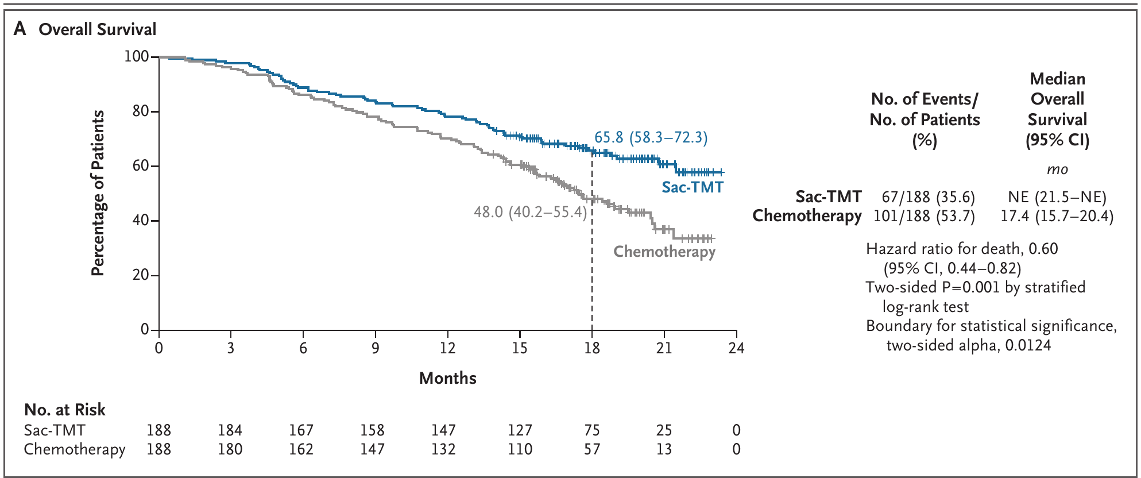
Sac-TMT Improves Overall Survival
OptiTROP-Lung04, preplanned interim analysis
HR 0.60 (95% CI, 0.44-0.82), two-sided P=0.001
Fang et al, NEJM 2026

Slide 23
Sac-TMT Has a Distinct Toxicity Profile
Treatment-related adverse events
 | Sac-TMT (n=188) | Chemotherapy (n=182)
Grade 3 or higher AE | 58.0% | 53.8%
Serious treatment-related AE | 9.0% | 17.6%
Neutropenia, grade ≥3 | 39.9% | 33.0%
Thrombocytopenia, grade ≥3 | 2.1% | 16.5%
Stomatitis, any grade | 64.4% | 4.9%
Sac-TMT: less serious toxicity, less thrombocytopenia, more stomatitis compared with chemo
Fang et al, NEJM 2026

Slide 24
EGFR-Mutant NSCLC After Osimertinib
Trial (regimen) | Exp ORR | Exp PFS,mo | PFS HR
OptiTROP-Lung04 (sac-TMT, n=376) | 61% | 8.3 | 0.49
Dato-DXd (EGFRm pool, n=117)† | 43% | 5.8 | N/A
HER3-DXd (HERTHENA-Lung01, n=225)† | 30% | 5.5 | N/A
HER3-DXD (HERTHENA-Lung02, n=586) | 35% | 5.8 | 0.77
Iza-bren (post-TKI RP2D, n=50)†‡ | 56% | 12.5 | N/A
OS negative, application withdrawn
All TOPO-1 ADCs
†Single-arm, no concurrent control. ‡Chemo-naive, post-TKI subgroup; full RP2D cohort (n=121, mixed prior chemo) showed ORR 49%, PFS 6.9 mo.
Fang et al, NEJM 2025; Passaro et al, Ann Oncol 2024; Goldman et al, WCLC 2025; Peled et al, ESMO Open 2025; Ahn et al, J Thorac Oncol 2025; Yu et al, JCO 2023; Mok et al, ASCO 2025. Hong et al, Ann Oncol 2026

Slide 25
Whatever happened to finding targets?

Slide 26
Savolitinib + Osimertinib vs Chemotherapy after osimertinib
Savolitinib +
Osimertinib
(n=TBD)
Advanced NSCLC
EGFR mutation
MET overexpression and/or amplification (central IHC / FISH)
Progression on 1st or 2nd line osimertinib as most recent therapy
Carboplatin or Cisplatin +
Pemetrexed
(n=TBD)
Primary endpoint: PFS by blinded independent central review
Secondary endpoints: overall survival, response rate, duration of response, disease control rate, CNS PFS, safety
SAFFRON, NCT05261399

Slide 27
Savolitinib + Osimertinib vs Chemotherapy after osimertinib
Advanced NSCLC
EGFR mutation
MET overexpression and/or amplification (central IHC / FISH)
Progression on 1st or 2nd line osimertinib as most recent therapy
Savolitinib +
Osimertinib
(n=TBD)
Carboplatin or Cisplatin +
Pemetrexed
(n=TBD)
Press Release positive,
to be presented at ESMO 2026
Primary endpoint: PFS by blinded independent central review
Secondary endpoints: overall survival, response rate, duration of response, disease control rate, CNS PFS, safety
SAFFRON, NCT05261399

Slide 28
Conclusions
After initial 3rd Generation EGFR TKI combination therapy, platinum-doublets with or without additional agents have shown efficacy.
There are many antibody-drug conjugates currently being studied. The ones most advanced in development all use a similar payload.
We look forward to hearing about approaches based on MET overexpression.
Don’t forget about local therapy for localized progressive disease!

